Slide 1
We will get started shortly.

Slide 3
Medical Disclaimer:
The information provided is for educational purposes and is not intended as medical advice, or a substitute for the medical advice of a physician or other qualified health care professional. This is for science and educational purposes only and cannot be used in any aspect for sales or marketing. You should not use this information for diagnosing a health or fitness problem or disease. You should always consult with a doctor or other health care professional for medical advice or information about diagnosis and treatment. This is Confidential. Do not distribute—for scientific educational purposes only.
Notes:
The information provided is for educational purposes and is not intended as medical advice, or a substitute for the medical advice of a physician or other qualified health care professional. This is for science and educational purposes only and cannot be used in any aspect for sales or marketing. You should not use this information for diagnosing a health or fitness problem or disease. You should always consult with a doctor or other health care professional for medical advice or information about diagnosis and treatment. This is Confidential. Do not distribute—for scientific educational purposes only.

Slide 4
ISNS Case Study Presented by: Dr. Norbert Ketskés
International Science Nutrition Society – CURARE CAUSAM -- ISNS 2023

Slide 5
Ulcerative Colitis
Ulcerative colitis (UC) is a type of inflammatory bowel disease (IBD). IBD comprises a group of diseases that affect the gastrointestinal (GI) tract.
UC occurs when the lining of your large intestine (also called the colon), rectum, or both become inflamed.
This inflammation produces tiny sores called ulcers on the lining of your colon. Inflammation usually begins in the rectum and spreads upward. It can involve your entire colon.
International Science Nutrition Society – CURARE CAUSAM -- ISNS 2023

Slide 6
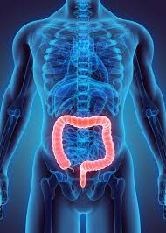
Ulcerative Colitis
The inflammation causes your bowel to move its contents rapidly and empty frequently. As cells on the surface of the lining of your bowel die, ulcers form. The ulcers may cause bleeding and discharge of mucus and pus.
While this condition affects people of all ages, most people develop UC between ages 15 and 30 years old, according to the American Gastroenterological Association. After 50 years old, there’s another small increase in diagnosis of IBD, usually in men.
International Science Nutrition Society – CURARE CAUSAM -- ISNS 2023

Slide 7
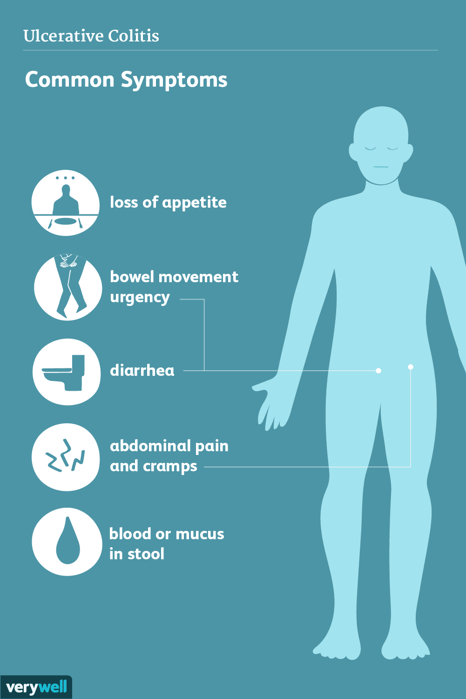
SYMPTOMS
The seriousness of UC symptoms varies among people who have the condition. The symptoms can also change over time.
People diagnosed with the UC may experience periods of mild symptoms or no symptoms at all. This is called remission. However, symptoms can return and become severe. This is called a flare-up.
Common symptoms of UC include:
Abdominal pain
Increased abdominal sounds
Bloody stools
Diarrhea
Fever
Rectal pain
Weight loss
Malnutrition
International Science Nutrition Society – CURARE CAUSAM -- ISNS 2023

Slide 8
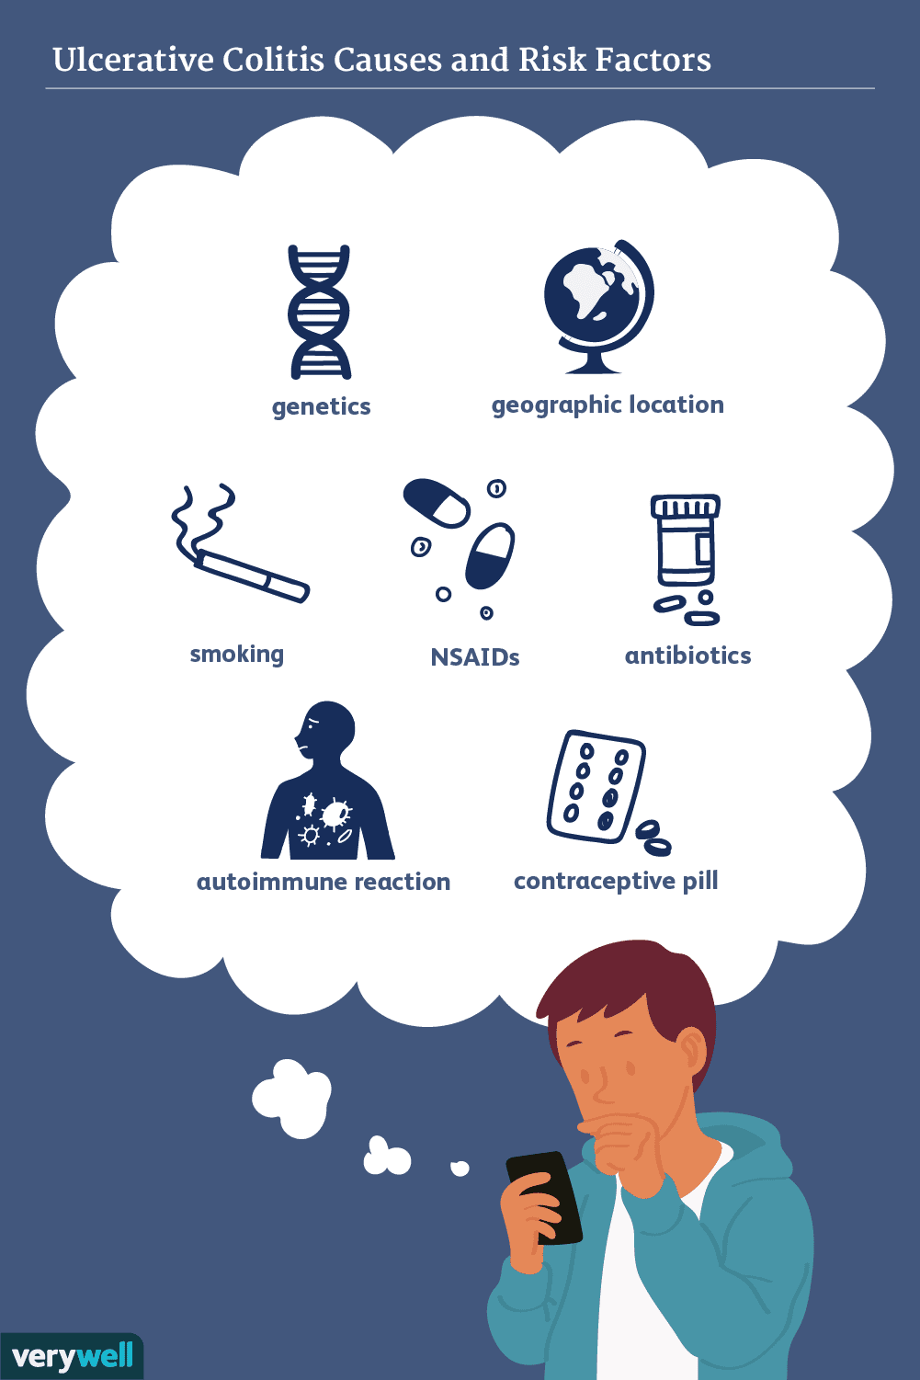
Ulcerative Colitis Causes
Researchers believe that UC may be the result of an overactive immune system. However, it is unclear why some immune systems respond by attacking the large intestines, and others don’t.
Factors that may play a role in who develops UC include:
Genes- You may inherit a gene from a parent that increases your chance of having UC.
Other immune disorders – If you have one type of immune disorder, your chance of developing a second is higher.
Environmental factors – Bacteria, viruses, and antigens may trigger your immune system.
International Science Nutrition Society – CURARE CAUSAM -- ISNS 2023

Slide 9
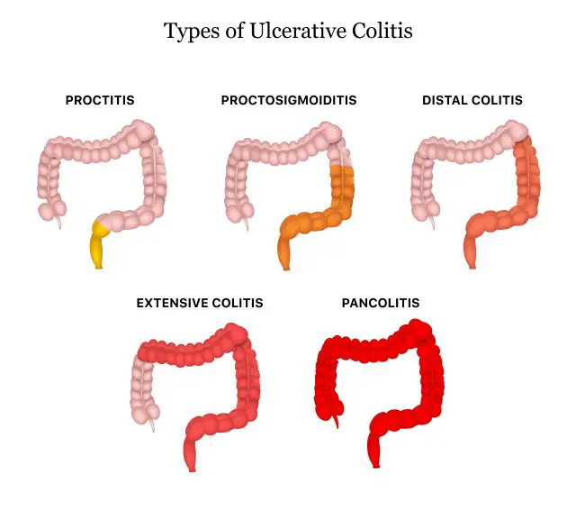
Types of Ulcerative Colitis
UC can be categorized according to the parts of the GI tract that it affects.
Ulcerative proctitis. In ulcerative proctitis, only the rectum is inflamed. It’s considered a mild form of UC
Left-sided colitis. Left-sided colitis causes inflammation in the area between the splenic flexure (near the upper part of the colon, where it bends) and the last section of the colon. The last section of the colon, known as the distal colon, includes the descending colon and sigmoid colon. Left-sided colitis is also known as distal ulcerative colitis.
Proctosigmoiditis. Proctosigmoiditis is a form of left-sided colitis. It causes inflammation in the rectum and sigmoid colon.
Extensive colitis. Extensive colitis, also known as pancolitis, causes inflammation throughout the entire colon. It’s considered a severe form of UC.
International Science Nutrition Society – CURARE CAUSAM -- ISNS 2023

Slide 10
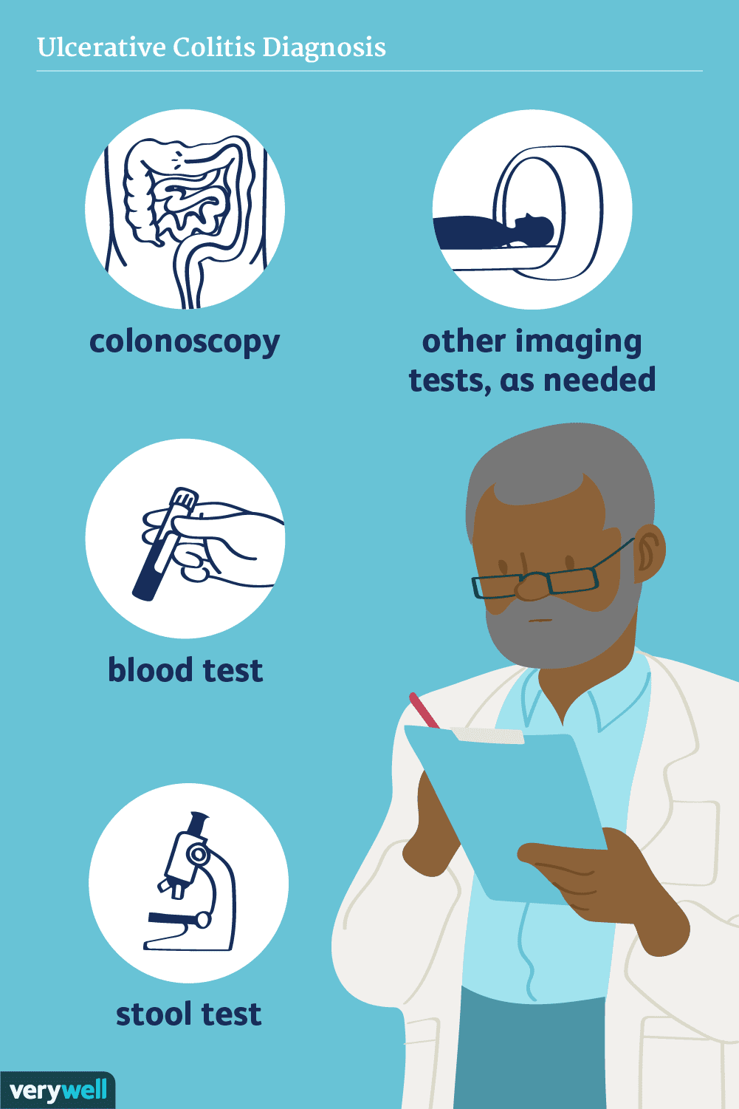
Ulcerative Colitis Diagnosis
Different tests can help a doctor diagnose UC. UC mimics other bowel diseases such as Crohn's disease. A doctor will order multiple tests to rule out other conditions.
Tests to diagnose UC often include:
Blood Tests- a complete blood count looks for signs of anemia (low red blood cell count). Other tests indicate inflammation, such as a high level of C-reactive protein and a high sedimentation rate.
Stool test- a doctor examines your stool for certain inflammatory markers, blood, bacteria, and parasites.
CT scan – this is a specialized X-ray of your abdomen and pelvis.
Endoscopy – a doctor uses a flexible tube to examine your stomach, esophagus and small intestine.
Biopsy – a surgeon removes a tissue sample from your colon for analysis
Flexible sigmoidoscopy – a flexible tube is inserted into the rectum so they can examine the sigmoid colon, and part of the descending colon.
Colonoscopy – a doctor inserts a lighted scope called a colonoscope into your rectum to examine the inside of your colon. It is also a type of endoscopy.
International Science Nutrition Society – CURARE CAUSAM -- ISNS 2023

Slide 11
PROPRIETARY BLENDS LEGEND
Proprietary Blend I: Silica, Vitamin C, and Trace Minerals
Proprietary Blend II: N-acetyl L-tyrosine, Anhydrous Caffeine, L-theanine, Velvet Bean Seed, Pine Bark, Curcumin, and Vitamin D
Proprietary Blend III: Black seed oil, Resveratrol, turmeric, Raspberry Ketones, Apple Cider Vinegar, Aloe Vera, and D-Ribose
Proprietary blend IV: Vitamin C, zinc sulfate, and vitamin D3
Proprietary blend V: Inulin, Green Banana flour, apple fiber, bacillus coagulans, spirulina, wheat grass, barley grass, alfalfa leaf, flax seed, psyllium husk powder, chlorella, broccoli, kale, spinach, green cabbage, parsley, aloe vera, cayenne pepper, blueberry powder, pomegranate seed powder, and MCT coconut oil powder
International Science Nutrition Society – CURARE CAUSAM -- ISNS 2023

Slide 12
Patient: Female
Age: 39 years old
History:
She doesn't smoke, she's stressed a lot, she doesn't do sports
She had a „bad” diet.
She was diagnosed with ulcerative colitis 3 years ago
It is an inflammatory bowel disease in which we distinguish between asymptomatic (rest or remission) and symptomatic (also called relapse or recurrence)
In this patient, unfortunately, recurrence occurred frequently, every months, with characteristic symptoms. These symptoms also greatly affected the patient's quality of life ...
Symptoms during the relapse period:
Abdominal pain, usually convulsive, urgent defecation stimulus, bloody, mucous, purulent stools, diarrhea, fatigue, feeling weak, extremely unwell, weight loss,
Symptoms during the remission period:
Weakness, fatigue, bloating, abdominal dyscomfort
Medications:
Remission period: sulfalazin 3000mg/day (3x2/day)
Relapse period: sulfalazin 6000mg/day (4x3/day) and steroid (methylprednisolone orally, with a decreasing dose of 24 mg) and mesalamine in the form of an enema, directly into the intestine
ISNS CASE STUDY:
International Science Nutrition Society – CURARE CAUSAM -- ISNS 2023

Slide 13
ISNS CASE STUDY:
Lab tests:
High inflammatory parameter (CRP: 98 mg/l, normal up to 5,0) and higher liver enzyme levels: ASAT-95 (U/L) (range 2-35), ALAT-98, (range 2-45), GGTP-152, (range 4-55 U/L)
Se Iron 5,1 (range 10,7-32,2 mikromol/l) (iron deficiency anaemia)
Haemoglobin: 101 (range 120-160 g/l)
Haematocrit: 0,28 (range 0,36-0,47 l/l)
Medications:
Remission period: sulfalazin 3000mg/day (3x2/day)
Relapse period: sulfalazin 6000mg/day (4x3/day) and steroid (methylprednisolone orally, with a decreasing dose of 24 mg) and mesalamine in the form of an enema, directly into the intestine
International Science Nutrition Society – CURARE CAUSAM -- ISNS 2023

Slide 14
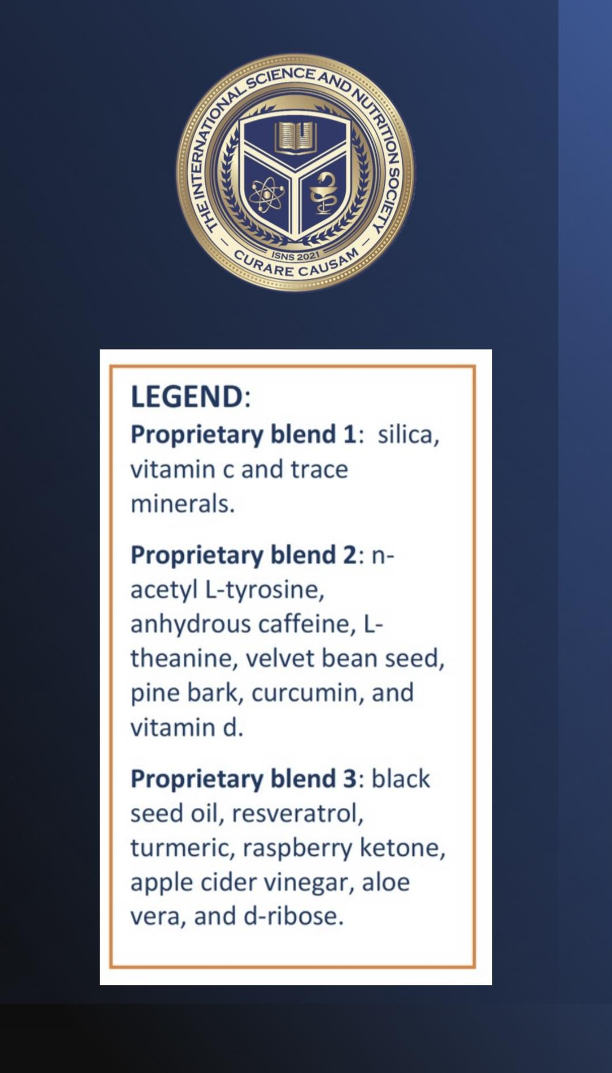
THERAPY
LEGEND: Proprietary Blend I: Silica, Vitamin C, and Trace Minerals Proprietary Blend II: N-acetyl L-tyrosine, Anhydrous Caffeine, L-theanine, Velvet Bean Seed, Pine Bark, Curcumin, and Vitamin D Proprietary Blend III: Black Seed Oil, Resveratrol, Turmeric, Raspberry Ketones, Apple Cider Vinegar, Aloe Vera, and D-ribose Proprietary Blend IV: Vitamin C, Zinc Sulfate, and Vitamin D3 Proprietary Blend V: Inulin, Green Banana Flour, Apple Fiber, Bacillus Coagulans, Spirulina, Wheat Grass, Barley Grass, Alfalfa Leaf, Flax Seed, Psyllium Husk Powder, Chlorella, Broccoli, Kale, Spinach, Green Cabbage, Parsley, Aloe Vera, Cayenne Pepper, Blueberry Powder, Pomegranate Seed Powder, and MCT Coconut Oil Powder
Proprietary blend I: 2x5 drops, morning and
evening, for 3 days, then every 3 days then
increased by 1-1 drops every 3 days to 2x10
Proprietary blend II :1 in the morning for 7 days, then 2, 1 in the morning and 1 in the afternoon
Proprietary blend III: 1/2 sachet in the morning
for 7 days then 1 sachet in the morning for 7 days then 1 sachet in the morning and 1 sachet in the evening
Proprietary blend IV: 1/2 teaspoon in the
morning
Proprietary blend V: 1 teaspoon in the
in the evening for 7 days, then 1 teaspoon in the morning and 1 teaspoon in the evening
Proprietary blend VI: 1 in the
morning for 7 days then 1 in the morning and 1 in the evening
International Science Nutrition Society – CURARE CAUSAM -- ISNS 2023

Slide 15
Other advice
Gluten-free diet!
Cow's milk poor and vegetable-rich diet
Exercises to achieve a positive mental and emotional state
(e.g: Yoga, meditation, breathing exercises, stress management)
LEGEND: Proprietary Blend I: Silica, Vitamin C, and Trace Minerals Proprietary Blend II: N-acetyl L-tyrosine, Anhydrous Caffeine, L-theanine, Velvet Bean Seed, Pine Bark, Curcumin, and Vitamin D Proprietary Blend III: Black Seed Oil, Resveratrol, Turmeric, Raspberry Ketones, Apple Cider Vinegar, Aloe Vera, and D-ribose Proprietary Blend IV: Vitamin C, Zinc Sulfate, and Vitamin D3 Proprietary Blend V: Inulin, Green Banana Flour, Apple Fiber, Bacillus Coagulans, Spirulina, Wheat Grass, Barley Grass, Alfalfa Leaf, Flax Seed, Psyllium Husk Powder, Chlorella, Broccoli, Kale, Spinach, Green Cabbage, Parsley, Aloe Vera, Cayenne Pepper, Blueberry Powder, Pomegranate Seed Powder, and MCT Coconut Oil Powder
International Science Nutrition Society – CURARE CAUSAM -- ISNS 2023

Slide 16
ISNS CASE STUDY:
RESULTS
After 1 month:
Fatigue, weakness, bloating decreased.
She was able to reduce sulfalazine from 3000 mg/day (3x2) to 1500 mg/day (3x1)
After 3 month:
The feeling of dyscomfort disappeared.
And great news is that the patient didn’t have relapse in the last 3 months!!!
She was able to reduce sulfalazine from 1500 mg/day to 500 mg/day (1x1) She is feeling well, there is no pain and her weight has increased!
Control Lab tests:
Inflammatory parameter CRP: (98!) 9 mg/l, (normal up to 5,0), liver enzyme levels: ASAT- (95!) 38 (U/L) (range 2-35), ALAT- (98!) 45, (range 2-45), GGTP- (152!) 50, range (4-55 U/L)
Se Iron (5,1!) 10,1 (range 10,7-32,2 mikromol/l)
Haemoglobin: (101!) 119 (range 120-160 g/l)
Haematocrit: (0,28!) 0,35 (range 0,36-0,47 l/l)
International Science Nutrition Society – CURARE CAUSAM -- ISNS 2023

Slide 17
Quality of Evidence Supporting the Role of Supplement Curcumin for the Treatment of Ulcerative Colitis: An Overview of Systematic Reviews Hongshuo Shi, Dan Wang, Wenqiang Chen, Yinghao Li, Guomin Si, and Tiantian Yang
Curcumin is a potential complementary treatment for ulcerative colitis (UC). This overview systematically summarizes and evaluates the existing evidence of curcumin in the treatment of UC.
Two researchers use the Assessment of Multiple Systematic Reviews 2 (AMSTAR-2), the Risk of Bias in Systematic Reviews (ROBIS) scale, the list of Preferred Reporting Items for Systematic Reviews and Meta-Analyses (PRISMA), and the Grading of Recommendations Assessment, Development, and Evaluation (GRADE) system to assess the included SRs/MAs.
One SR/MA showed that curcumin can significantly increase the summary rate of endoscopic improvement and remission, and 2 SRs/MAs reported that curcumin can significantly increase the endoscopic improvement rate; in addition, 3 SRs/MAs reported curcumin can significantly improve the endoscopic remission rate.
One SR/MA that curcumin can significantly reduce CRP and ESR levels.
Curcumin may be an effective and safe complementary treatment for UC. However, further standard and comprehensive SRs/MAs and RCTs are needed to provide an evidence-based medical rationale for this.
https://www.ncbi.nlm.nih.gov/pmc/articles/PMC8896949/
International Science Nutrition Society – CURARE CAUSAM -- ISNS 2023

Slide 18
Randomized, double-blind, placebo-controlled trial of aloe vera gel for active ulcerative colitis L Langmead, R M Feakin, S Goldthorpe, H Holt, E Tsironi, A De Silva, D P Jewell, D S Rampton
The aim of this study was to perform a double-blind, randomized, placebo-controlled trial of the efficacy and safety of aloe vera gel for the treatment of mildly to moderately active ulcerative colitis.
Forty-four evaluable hospital out-patients were randomly given oral aloe vera gel or placebo, 100 mL twice daily for 4 weeks, in a 2 : 1 ratio. The primary outcome measures were clinical remission (Simple Clinical Colitis Activity Index </= 2), sigmoidoscopic remission (Baron score </= 1) and histological remission (Saverymuttu score </= 1).
Clinical remission, improvement and response occurred in nine (30%), 11 (37%) and 14 (47%), respectively, of 30 patients given aloe vera, compared with one (7%) [P = 0.09; odds ratio, 5.6 (0.6-49)], one (7%) [P = 0.06; odds ratio, 7.5 (0.9-66)] and two (14%) [P < 0.05; odds ratio, 5.3 (1.0-27)], respectively, of 14 patients taking placebo.
Oral aloe vera taken for 4 weeks produced a clinical response more often than placebo; it also reduced the histological disease activity and appeared to be safe. Further evaluation of the therapeutic potential of aloe vera gel in inflammatory bowel disease is needed.
https://onlinelibrary.wiley.com/doi/10.1111/j.1365-2036.2004.01902.x
International Science Nutrition Society – CURARE CAUSAM -- ISNS 2023

Slide 19
Vitamin D Modulates Intestinal Microbiota in Inflammatory Bowel Diseases Carolina Battistini, Rafael Ballan, Marcos Edgar Herkenhoff, Susana Marta Isay Saad, and Jun Sun
Vitamin D (VitD) is involved in immune cell differentiation, gut microbiota modulation, gene transcription, and barrier integrity.
VDR regulates functions of T cells and Paneth cells and modulates release of antimicrobial peptides in gut microbiota-host interactions.
Vitamin D supplementation contributes to the reduction of inflammation in individuals with IBD and can promote changes in the human microbiota.
VDR is a crucial factor for gut microbiota homeostasis, having a great impact on the metabolome profile as well.
The downregulation of VDR is related to an upregulation of intestinal CYP27B as a homeostatic anti-inflammatory response, while the VDR function is implicated in regulatory T cells and Paneth cells differentiation, as well as in antimicrobial peptides release, and the gut microbiota seemed to play a critical role in these processes.
https://www.ncbi.nlm.nih.gov/pmc/articles/PMC7795229/
International Science Nutrition Society – CURARE CAUSAM -- ISNS 2023

Slide 20
References
https://www.niddk.nih.gov/health-information/digestive-diseases/ulcerative-colitis
https://medlineplus.gov/ulcerativecolitis.html
https://www.ncbi.nlm.nih.gov/pmc/articles/PMC8896949/
https://onlinelibrary.wiley.com/doi/10.1111/j.1365-2036.2004.01902.x
https://www.ncbi.nlm.nih.gov/pmc/articles/PMC7795229/
International Science Nutrition Society – CURARE CAUSAM -- ISNS 2023

Slide 21
Thank you for joining us today!
International Science Nutrition Society – CURARE CAUSAM -- ISNS 2023

